Slide 1
Neural tube defects
SYLVIA NANJALA SIMIYU

Slide 2
NEURAL TUBE DEFECTS
They result from a failure of the neural tube to close in utero between the 3rd and 4th week of gestation
Factors related to neural tube defects-
Maternal radiation. Maternal drugs
Maternal exposure to chemicals
Maternal malnutrition.
Genetic determinants

Slide 3
Types of neural tube defects
Spina bifida- most frequent and benign NTD. Sometimes referred to as spina bifida occulta.
Usually detected on an Xray which reveals defective closure of the posterior arch of the vertebrae usually between L5 & S1.
Mostly asymptomatic
Sometimes, there is loss of bladder and bowel control, and also cavus deformities of the feet.

Slide 4
NTDs
Spina bifida cystica- there's is a defect in closure of the vertebral column with rachichisis (condition where the neural tube fails to close completely)
Presence of a protruding sac.
Protruding sac may contain
Meninges- meningocele
Spinal cord/nerves- myelocele
Both meninges and spinal nerves- myelomeningocele

Slide 5
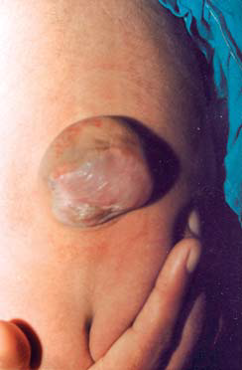
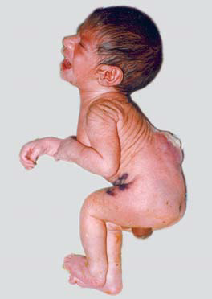
Spina bifida cystica
Meningocele
Meningomyelocele

Slide 6
Meningocele
Fluctuant midline sac of meninges that herniates through a defect in the posterior vertebral arch.
It transilluminates easily.
Usually asymptomatic and well covered with skin
Associated anomalies include- hydrocephalus, diastematomyelia, tethered cord and leima

Slide 7
Meningocele
Diastematomyelia- congenital disorder where part of the spinal cord is split, usually at the upper lumbar vertebral level.
Surgical intervention may be delayed unless there are neurological symptoms such as thin skin, or CSF leak

Slide 8
Myelomeningocele
AKA meningomyelocele
It is a midline cystic sac of meninges and spinal tissue that herniates through a defect in the posterior vertebral region, usually the lumbar sacral area.
It transilluminates less easily.- indicates presence of nerves in the sac.
Covered only with thin skin.

Slide 9
Myelomeningocele
Usually accompanied with neurological deficits e.g. flaccid paralysis, absent drop reflexes and absent sensations
Others- club foot, subluxation of the hip, joint contractures scoliosis, kyphosis.
In cases of meningomyelocele of the thoracic or cervical spine, it is accompanied with spasticity, hyperactive reflexes and hydrocephalus

Slide 10
Diagnosis
Xray
CT scan
MRI
Neurological assessment
Prenatally, elevated alpha fetoprotein in maternal serum and amniotic fluid are indicative of spina bifida cystica

Slide 11
Management of meningomyeocele
Due to risk of rapture of the sac and accompanying meningitis infection, surgery is advocated for, followed by a shunting procedure in case hydrocephalus coexisted with it.
Correction of musculoskeletal deformities
Regulation of bladder and bowel functions

Slide 12
Supportive measures
Injury and infection prevention of sac by appropriate positioning, sterile dressing
Prevent skin breakdown
Monitor for signs of hydrocephalus
Nutrition
Promote elimination
Prevent leg and hip deformities

Slide 13
Complications of spina bifida cystica
If not well covered with skin, the sac can easily rupture, increasing the risk of meningitis.
When the spinal cord or lumbosacral nerve roots are involved, as is usual, varying degrees of paralysis occur below the involved level. Since this paralysis occurs in the fetus, congenital orthopedic problems can present at birth (eg, clubfoot, arthrogryposis, dislocated hip). The paralysis usually affects bladder and rectal functions, and the resulting GU disorder can eventually lead to severely damaged kidneys.

Slide 14
Complications of spina bifida cystica
Kyphosis, sometimes associated with spina bifida, can hinder surgical closure and prevent the patient from lying supine.
Hydrocephalus occurs commonly and may be related to aqueductal stenosis or an Arnold-Chiari malformation. Other congenital anomalies may be present

Slide 15
Prevention of NTDs
The major way to prevnt NTDs is- folic acid supplementation

Slide 16
Thank you.

